Slide 1
Introduction to programming
Billy Stack

Slide 2
About the course
Explain the most fundamental concepts
In Java but may delve into other languages
Some object based principles
Apply decision making structures
Apply repetition control structures
Implement test and debug small non-visual applications

Slide 3
How it will be marked?
Continuous Assessment 1 – 10%
Continuous Assessment 2 – 20%
Final Exam – 70%

Slide 4
Programming language
What is a programming language?
A formal language designed to communicate instructions to a machine
What is an IDE?
Usually a software program that enables you to develop, debug and test software programs that you write – by giving you a friendly environment with helper tools
Different types of languages/environments
Language history
Structured/object oriented/functional/dynamic
Compile and execute?

Slide 5
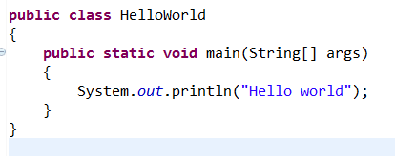
Sample “Hello World” application
Class
“main” method
Using system
Compiling and executing
Brackets

Slide 6
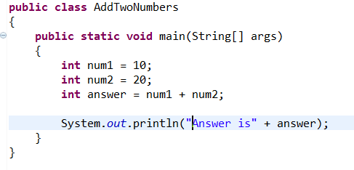
Sample “AddTwoNumbers”
Use of “int” variables
Printing out a variable
Note: Naming

Slide 7
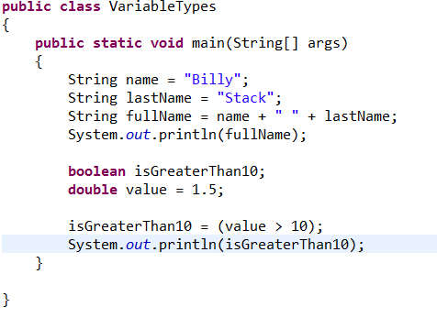
Variable types
Different types
Automated boolean assignment

